Slide 1
Embedded Software: Middleware and Application Software
CSPC61 - Embedded Systems Architectures
Dr. M. Bhuvaneswari
18.04.2022

Slide 2
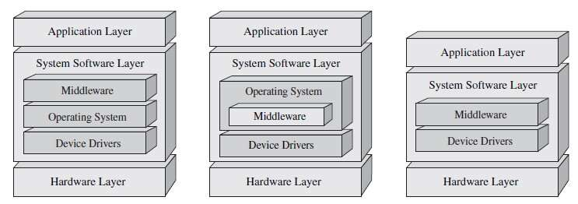
Middleware
Middleware is software that bridges gaps between other applications, tools, and databases in order to provide unified services to users.
In an embedded system middleware is system software.
It lies between – on device drivers or on top of the OS or incorporated within the OS itself
Software that mediates between application software and the kernel or device driver software.
It is an abstraction layer used on embedded devices with two or more applications in order to provide flexibility, security, portability, connectivity, intercommunication, and/or interoperability mechanisms between applications.
Main strengths of using middleware - it allows for the reduction of the complexity of the applications by centralizing software infrastructure.
Additional overhead – Scalability and performance. Embedded system – all layers
Middleware within the Embedded Systems Model

Slide 3
Middleware
There are many different types of middleware elements
Message oriented middleware (MOM)
Object request brokers (ORBs)
Remote procedure calls (RPCs)
Database/database access, and networking protocols
Most types of middleware - two general categories
General-purpose - They are implemented in a variety of devices, such as networking protocols of the OSI model, file systems, or some virtual machines such as the JVM.
Market-specific - they are unique to a particular family of embedded systems - digital TV standard-based software that sits on an OS or JVM.
A middleware element can be further categorized as proprietary or open
Proprietary - it is closed software supported by a company that licenses it.
Open - it is standardized by some industry committee and can be implemented and/or licensed by any interested party.

Slide 4
Middleware
More complex embedded systems have more than one middleware elements.
Difficult - Find one technology that supports all specified application requirements.
For the use of embedded system - Integrated middleware packages are available commercially, off the-shelf
Sun embedded Java solutions, Microsoft’s .NET Compact Framework, and CORBA from the Object Management Group (OMG).
Many embedded OS vendors also provide integrated middleware packages
run “out-of-the-box” with their respective OS and hardware platforms.

Slide 5
Application Software
In embedded system - application software sits on top of the system software layer, and is dependent on, managed, and run by the system software.
Software within the application layer - what type of embedded system device.
The functionality of an application represents at the highest level the purpose of that embedded system.
It does most of the interaction with users or administrator
Embedded applications – categorized - market specific (video-on-demand applications in a interactive digital TV) or general-purpose (Browser)

Slide 6
Application Layer Software Examples
Consider we need a devices that need to be able to
connect to other devices to transfer data or
have the remote device perform functions on command,
An application networking protocol must be implemented in some form in the application layer.
Networking protocols at the application level are independent of the software that they are implemented in.
Application-specific protocol can be implemented
within a stand-alone application whose sole function is the implementation of that protocol.
as a sub-unit of a larger application that provides many functions.

Slide 7
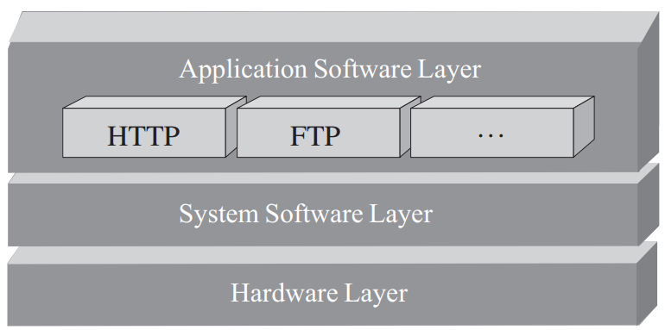
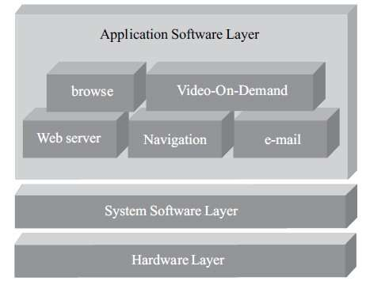
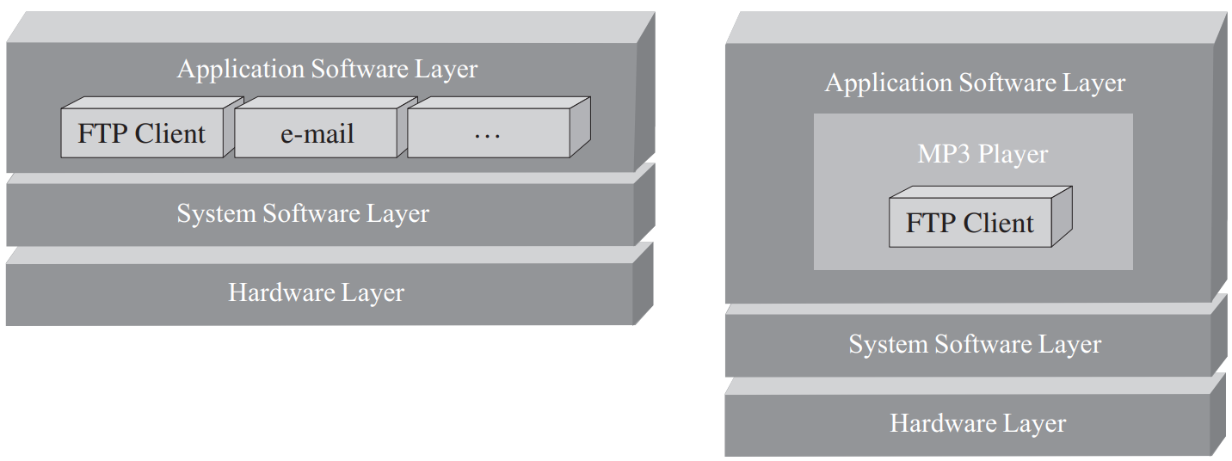
Application Layer Software Examples
Application software and networking protocols
Application software

Slide 8
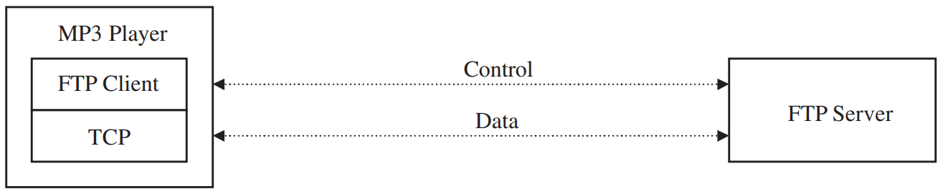
File Transfer Protocol (FTP) Client Application Example
FTP is a simplest protocols used to securely exchange files over a network.
It is based upon RFC959.
It can be implemented as a standalone application, to transfer files between networked devices, or within applications such as browsers and MP3 applications.
FTP protocol defines the communication mechanisms between the device initiating the transfer (FTP client or user-protocol interpreter (user PI)), and the device receiving the FTP connection (FTP Server or FTP Site).
Two type of connections - FTP client and servers.
Control connection - commands are transmitted between the devices.
Data connection - files are transmitted.
FTP network

Slide 9
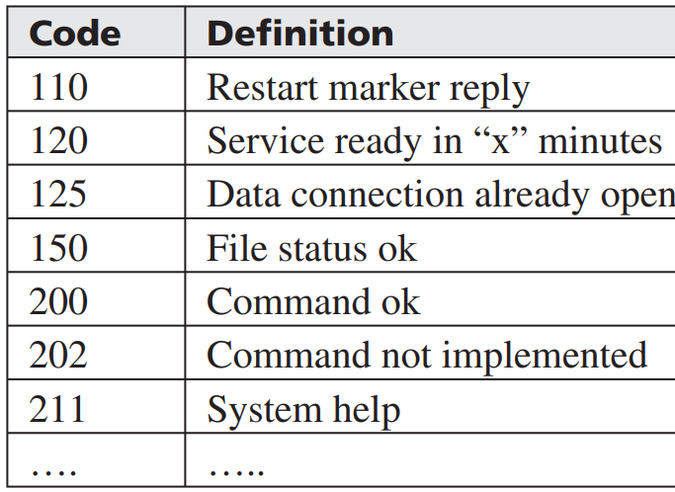
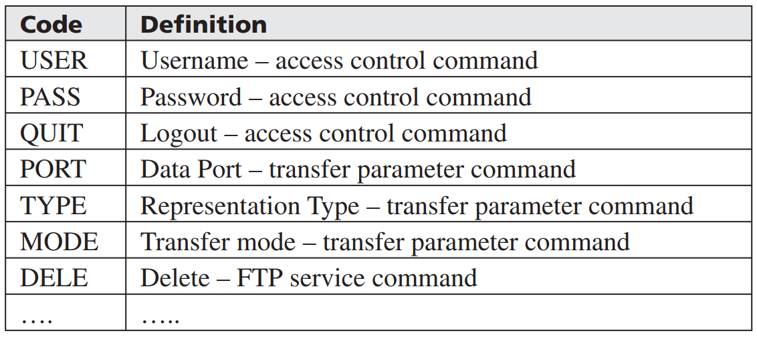
File Transfer Protocol Client Application Example
An FTP session starts - FTP client initiating a control connection by establishing a TCP connection to port 21 of the destination device.
The FTP client, after transmitting its commands, waits for the FTP Server to respond with a reply code over the control connection. RFC 959 standard - FTP reply codes
If the response from the FTP server is favorable, the FTP client then sends commands that specify parameters for access control, transfer criteria, transaction (store, retrieve, append, delete, etc)
FTP Reply Codes
FTP commands

Slide 10
File Transfer Protocol Client Application Example
FTP client needs to provide mechanisms that support the user to transmit the different types of commands as well as process any response codes received.
The FTP Server initiates the data connection and any transfers according to the commands specified by the FTP client.

Slide 11
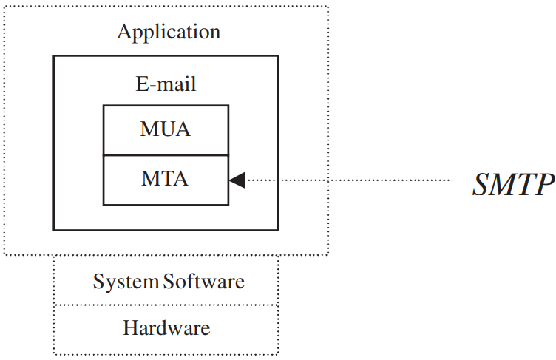
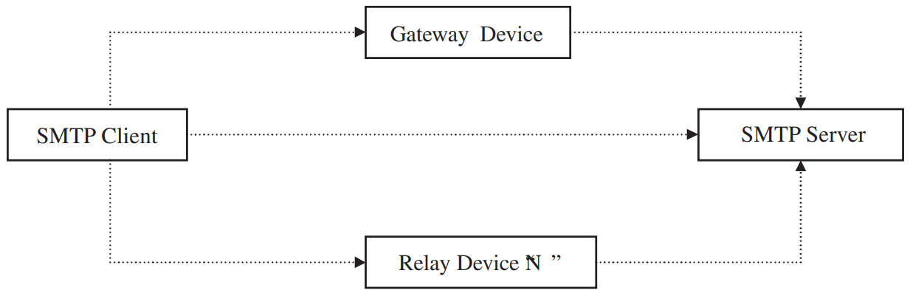
Simple Mail Transfer Protocol & E-Mail Example
SMTP is a simple application-layer protocol that is implemented within an e-mail application for sending mail messages between devices.
E-mail can be transmitted - destination directly, or via gateways and/or relay devices.
sender of an e-mail – SMTP Client, recipient of an e-mail - SMTP server
RFC 2821, e-mail applications are typically made up of two major components
Mail User Agent (MUA) is the interface to the user that generates the e-mail
Mail Transfer Agent (MTA) handles the underlying SMTP exchange of e-mails
Components of Email app
SMTP network diagram

Slide 12
Simple Mail Transfer Protocol & E-Mail Example
The SMTP protocol specifically defines two main mechanisms relative to send e-mails.
The e-mail message format and The transmission protocol
According to SMTP protocol, an e-mail is made up of three parts: the header, the body, and the envelope.
According to RFC2821
An e-mail’s header - Reply-To, Date, and From.
The body is the actual content of the message being sent, is made up of NVT ASCII characters and is based upon RFC2045 MIME specification
Contents of the envelope includes the addresses of the sender and recipients
After an e-mail is written and the “send” button is hit, the MUA adds a few additional headers, and then passes the content to the MTA.
MTA also adds headers of its own, incorporates the envelope, and then begins the procedure of transmitting the e-mail to the MTA on another device.

Slide 13
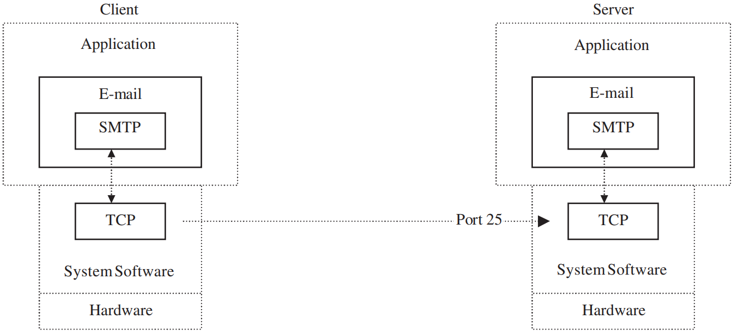
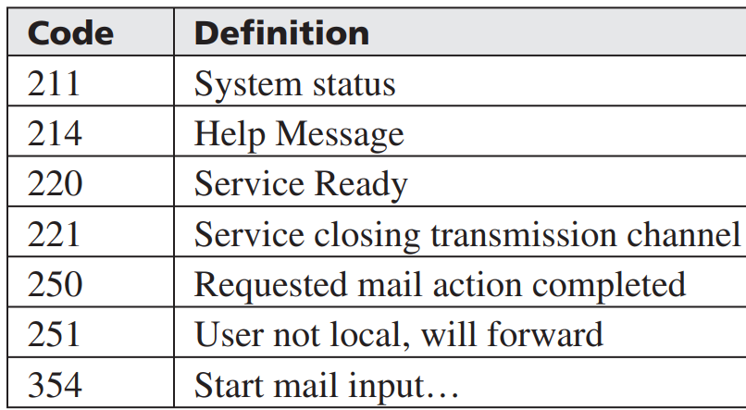
Simple Mail Transfer Protocol & E-Mail Example
The SMTP protocol requires its underlying transport protocol to be a reliable, ordered data stream channel, such as TCP.
SMTP on the client device starts the transmission mechanism by establishing a TCP connection to port 25 of the destination device.
The device transmitting the e-mail (the client) then waits for the receiver (the server) to respond with reply code 220.
E-mail and TCP
SMTP Reply Codes

Slide 14
Simple Mail Transfer Protocol & E-Mail Example
RFC2821 actually defines a list of reply codes that a server must use when responding to a client.
Upon receiving the e-mail, the server starts by sending its identity, a fully qualified domain name of the server’s host, and reply code to the client.
If the reply code indicates the server won’t accept the message, the client releases the connection.
An error report is sent back to the client along with the undeliverable message.
If the server responds - a reply code of 220 - the server is willing to accept the e-mail.
In this case, the client then informs the server who the sender and recipients are.
SMTP transmission protocol is based upon commands with arguments, referred to as mail objects that represent the data being transmitted - envelope and content.
There are specific commands to transmit specific types of data.

Slide 15
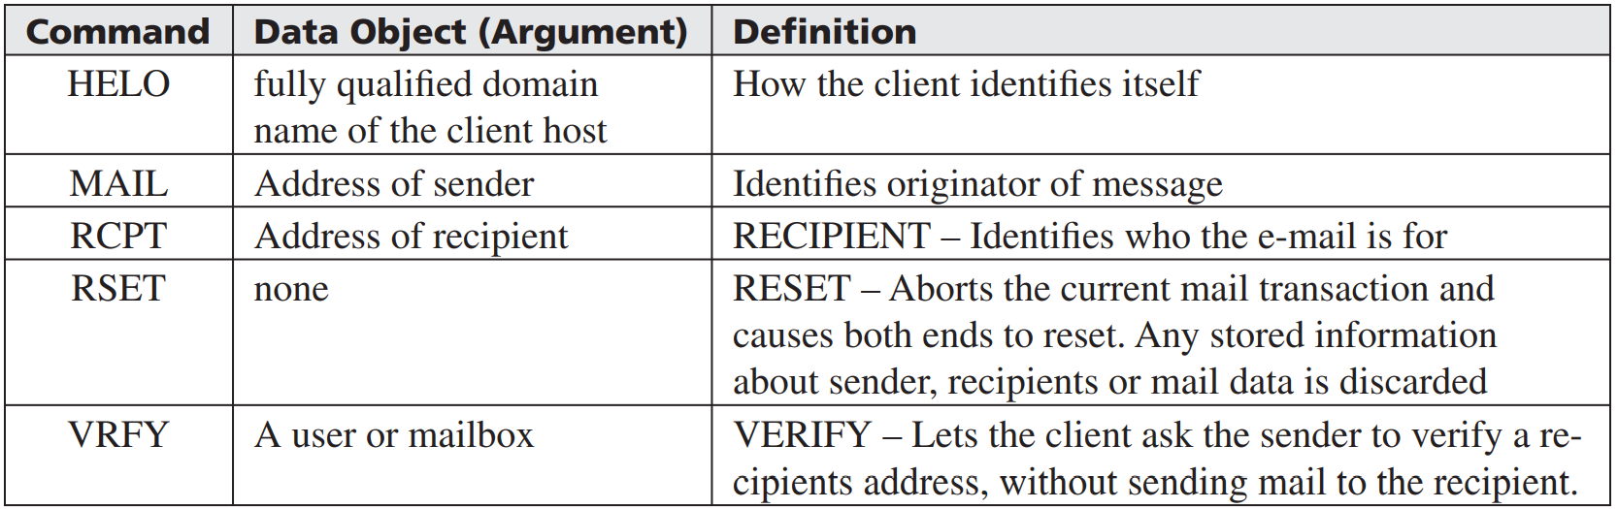
Simple Mail Transfer Protocol & E-Mail Example
MAIL command whose data object is the address of the sender, RCPT command whose mail object is the forward-path, DATA command whose mail object is the e-mail content.
SMTP server responds to each command with a reply code.
SMTP defines different buffers that can be implemented on a server
“mail-data” buffer to hold the body of an e-mail, a “forward-path” buffer to hold the addresses of recipients, “reverse-path buffer” to hold addresses of senders.
This is because data objects that are transmitted can be held pending a confirmation by the sender that the “end of mail data” has been transmitted by the client device.
checksums are usually not needed in a SMTP algorithm to verify the integrity of the data.
SMTP Command

Slide 16
Hypertext Transfer Protocol Client and Server
HTTP is the most widely implemented application layer protocol, used to transmit all types of data over the Internet.
Under the HTTP protocol, this data (referred to as a resource) is identifiable by its URL (Uniform Resource Locator).
HTTP is a based upon the client-server model that requires its underlying transport protocol to be a reliable, ordered data stream channel – TCP.
The HTTP transaction starts with the HTTP client opening a connection to an HTTP server by establishing a TCP connection to default port 80 of the server.
The HTTP client sends a request message for a particular resource to the HTTP Server.
The HTTP Server responds by sending a response message to the HTTP client with its requested resource.
After the response message is sent, the server closes the connection.

Slide 17
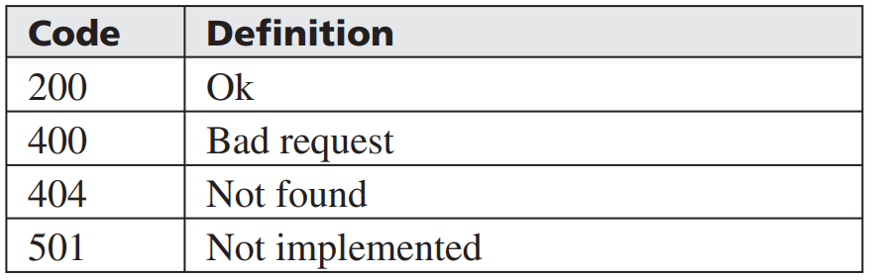
Hypertext Transfer Protocol Client and Server
The syntax of request and response messages - have headers - contain message attribute information that varies according to the message owner, and a body that contains optional data, where the header and body are separated by an empty line
The various methods and reply codes that can be implemented in an HTTP Server.
Delete, get, post, head, put, trace
HTTP reply codes

